Slide 1

CSE 350 Digital Electronics and Pulse Techniques
Comparator and Schmitt Trigger
Course Instructor: Shomen Kundu (SDU)
Mail: shomen.kundu@bracu.ac.bd
Desk: 4N166

Slide 2
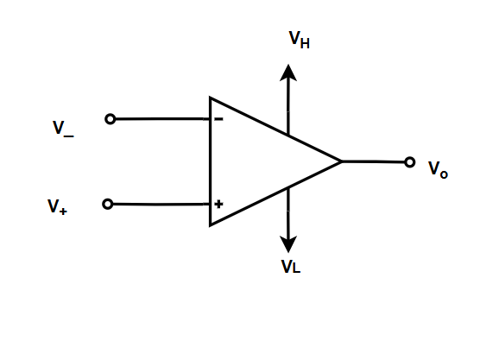
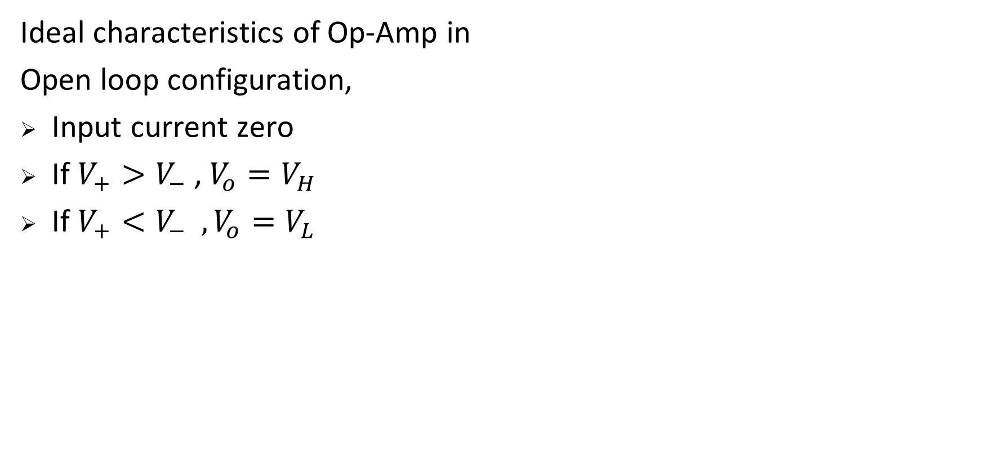
Op-Amp

Slide 3
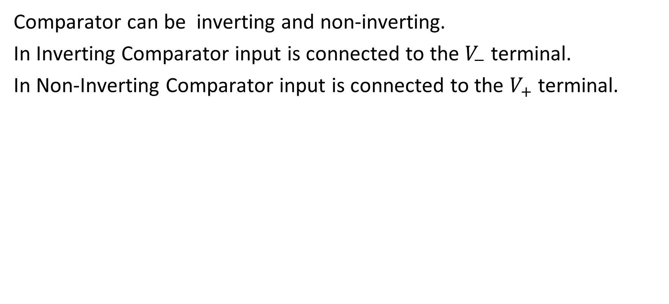
Op-Amp Comparator

Slide 4
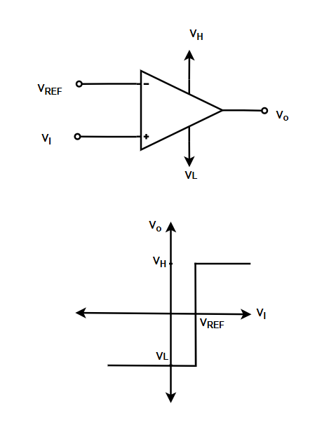
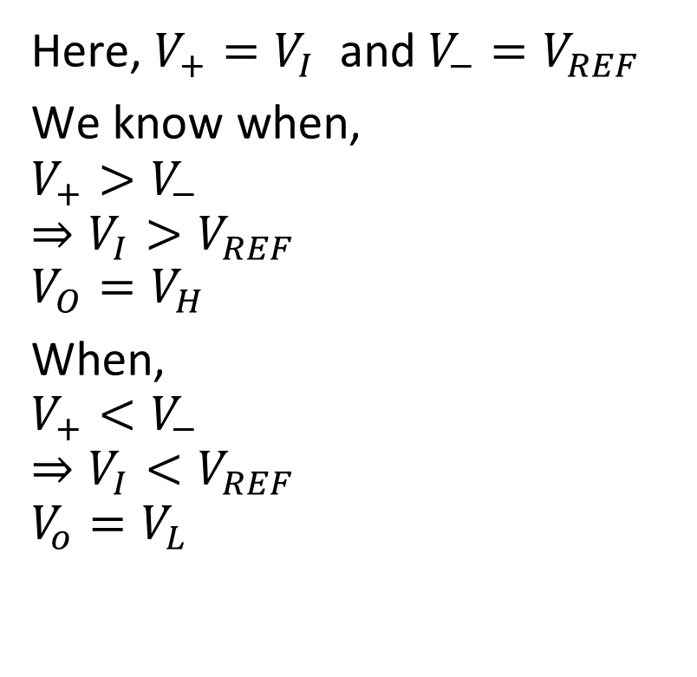
Non-Inverting Comparator

Slide 5
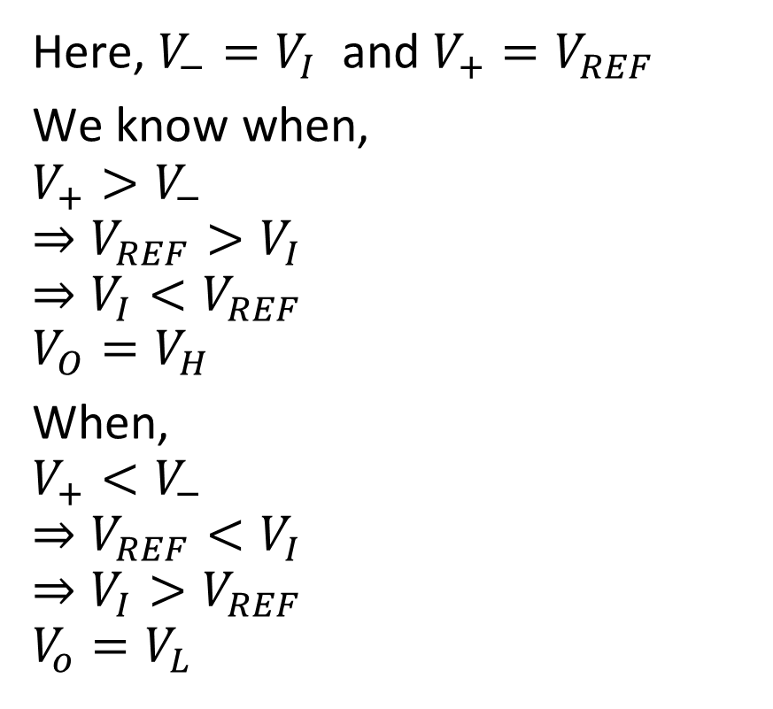
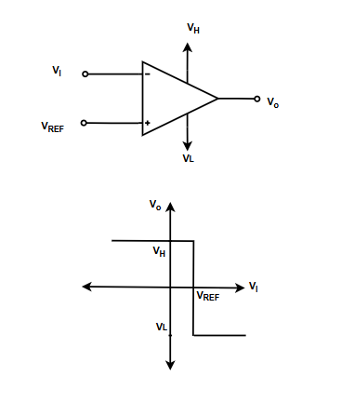
Inverting Comparator

Slide 6
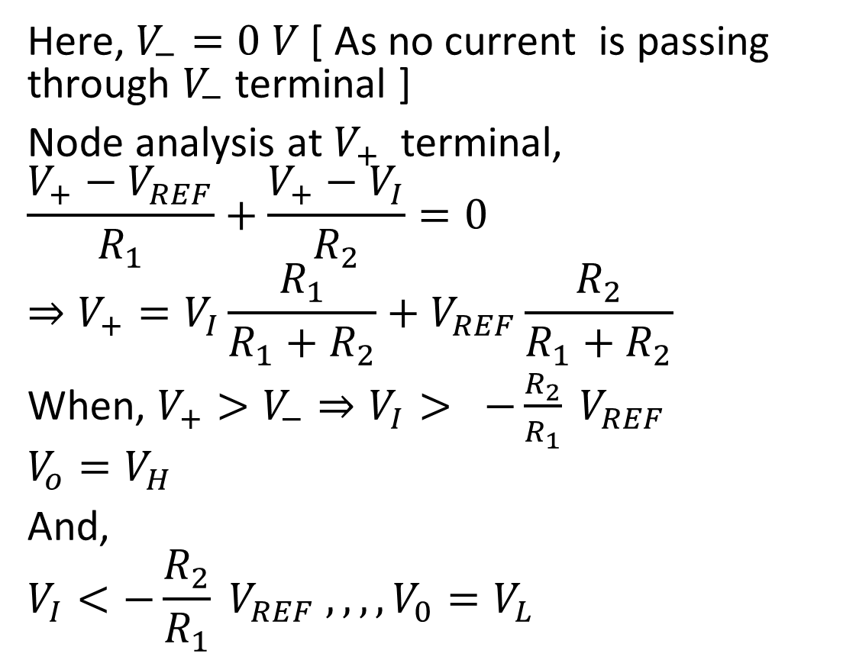
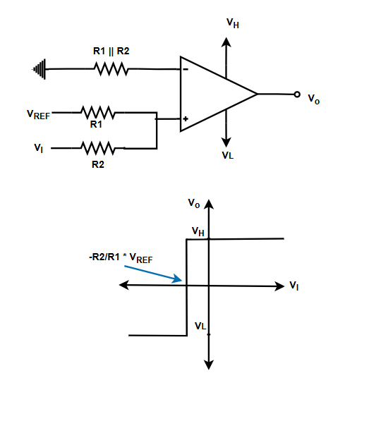
Non-Inverting Comparator with Divider

Slide 7
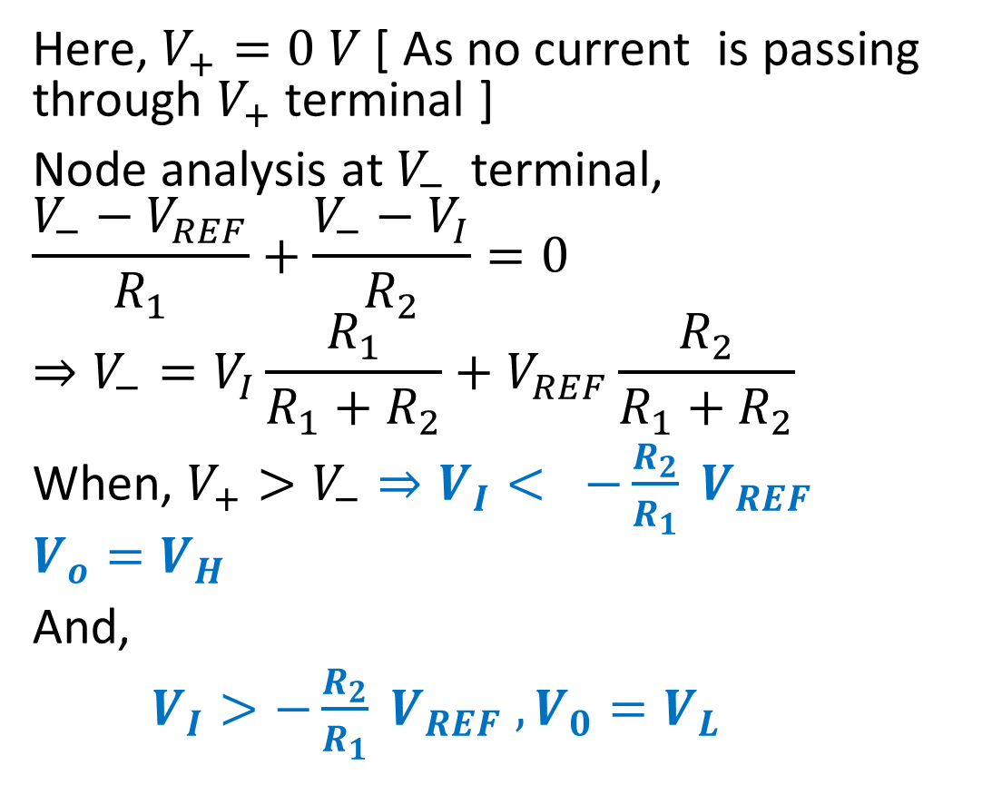
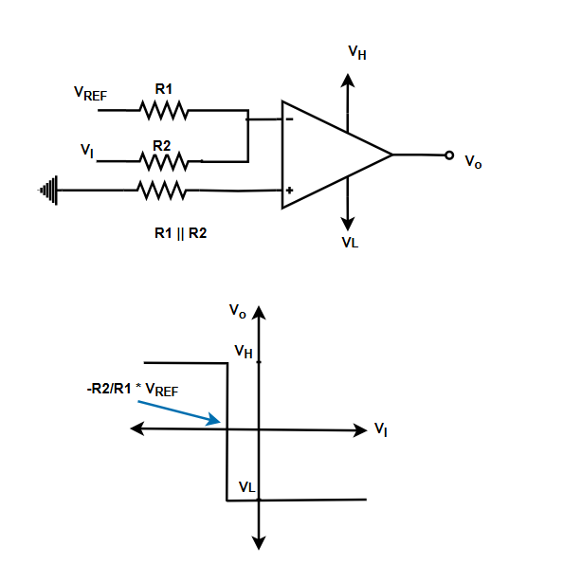
Inverting Comparator with Divider

Slide 8
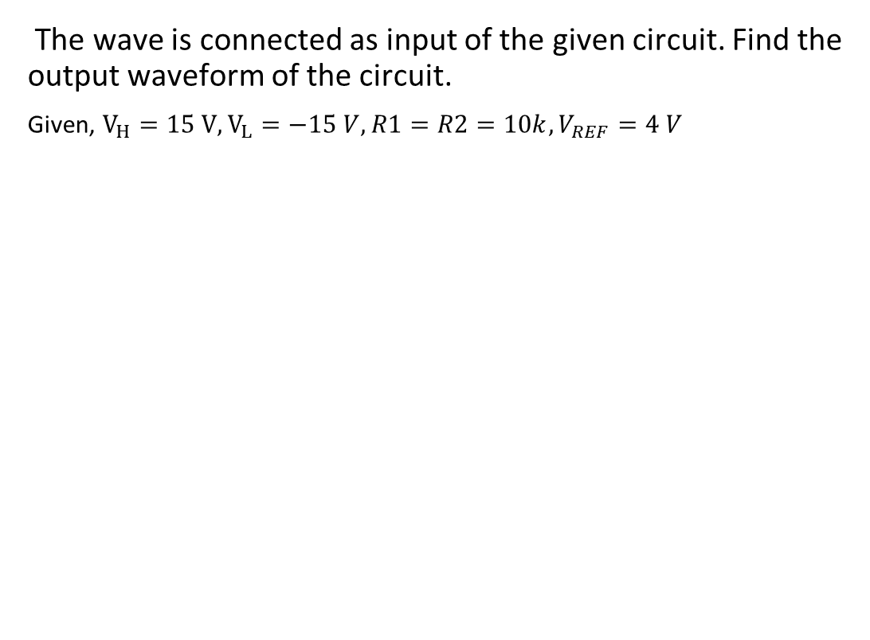
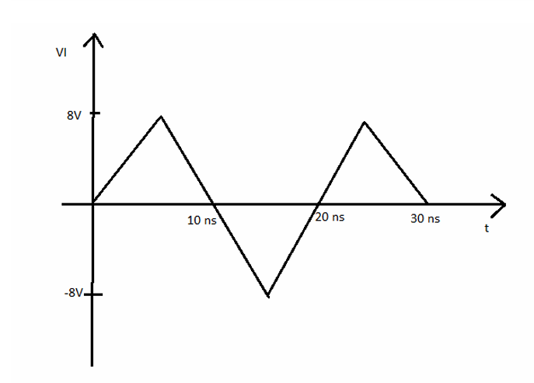
Exercise

Slide 9
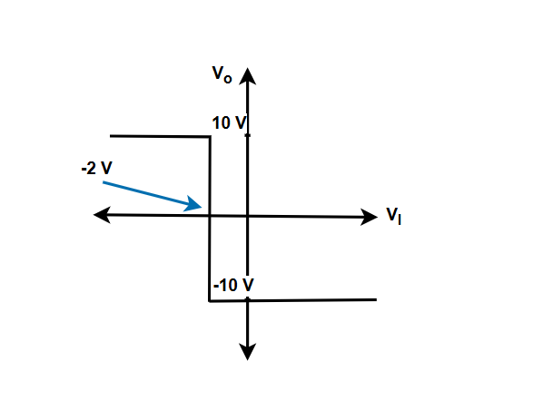
Exercise
Design a comparator circuit that will show the given transfer curve. You need to use 5 V as reference voltage.

Slide 10
Exercise
Design a comparator for street light control system. The photodetector detect light intensity and outputs a corresponding voltage. The detector output is 0 V when intensity of light is 0% of Max intensity and 5 V when the intensity of light Maximum. Design the comparator such that it can turn on the street light when the intensity is below 15% of the Max Light intensity.
You must satisfy all the mentioned criteria, and assume any component values accordingly.

Slide 11
Schmitt Trigger circuit
We will study 4 types of Schmitt Trigger circuit
Inverting ST
Non-inverting ST
Inverting ST with Ref
Non-inverting with Ref

Slide 12
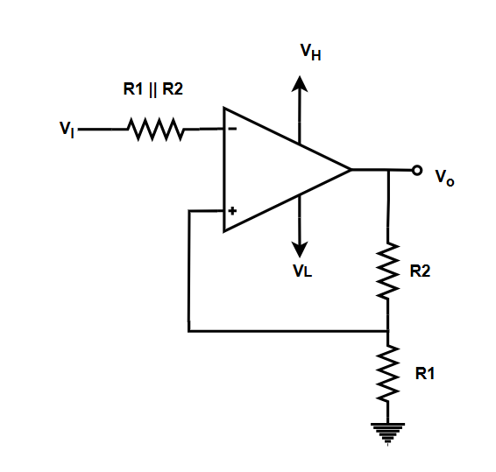

Inverting ST
Here, $V_{−}=V_{I}$, $V_{+}=V_{o}\frac{R_{1}}{R_{1}+R_{2}}$
We need to know previous output for calculating the next output.

Slide 13
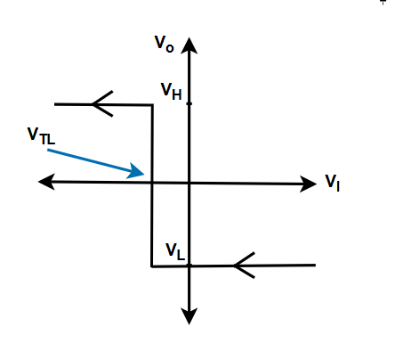
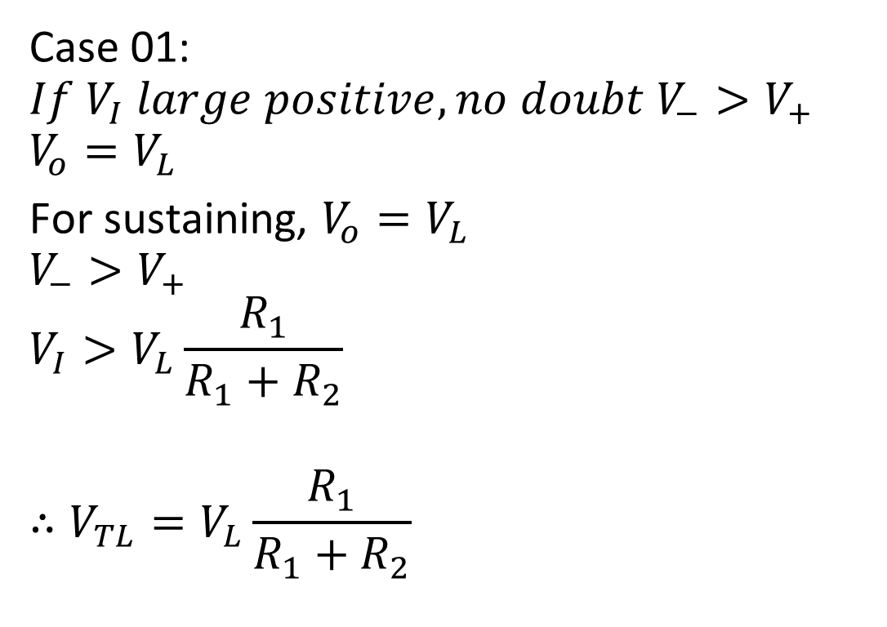
Inverting ST
Case 01:
$${If V}_{I} large positive,no doubt V_{−}>V_{+}$$
$$V_{o}=V_{L}$$
For sustaining, $V_{o}=V_{L}$
$$V_{−}>V_{+}$$
$$V_{I}>V_{L}\frac{R_{1}}{R_{1}+R_{2}}$$
$$∴V_{TL}=V_{L}\frac{R_{1}}{R_{1}+R_{2}}$$

Slide 14
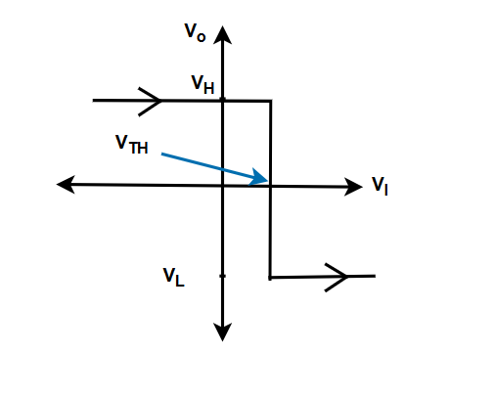
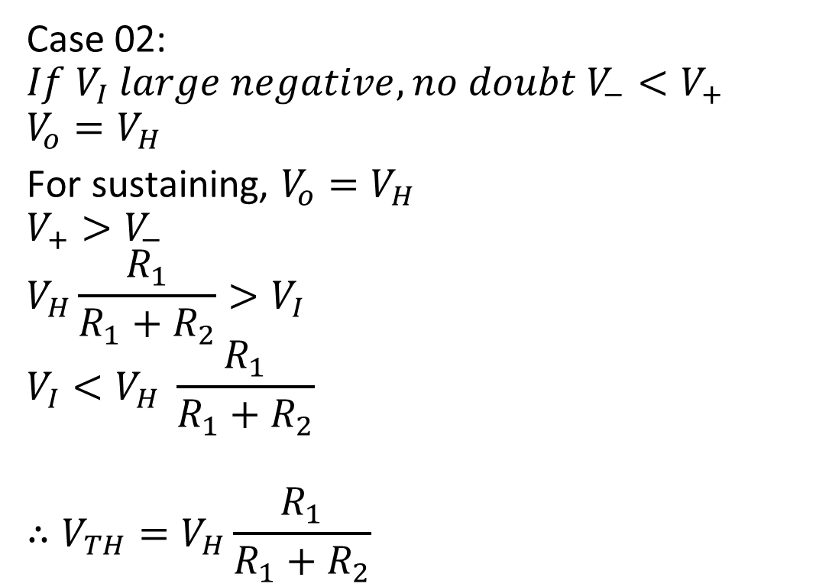
Inverting ST
Case 02:
$${If V}_{I} large negative,no doubt V_{−}<V_{+}$$
$$V_{o}=V_{H}$$
For sustaining, $V_{o}=V_{H}$
$$V_{+}>V_{−}$$
$$V_{H}\frac{R_{1}}{R_{1}+R_{2}}>V_{I}$$
$$V_{I}<V_{H} \frac{R_{1}}{R_{1}+R_{2}}$$
$$∴V_{TH}=V_{H}\frac{R_{1}}{R_{1}+R_{2}}$$

Slide 15
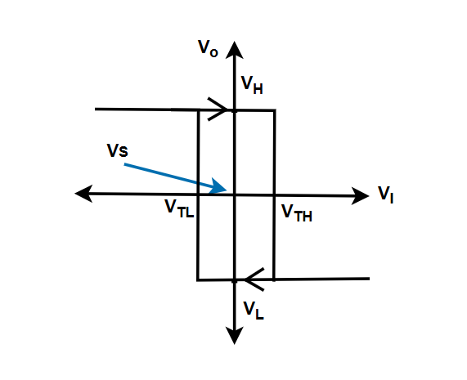
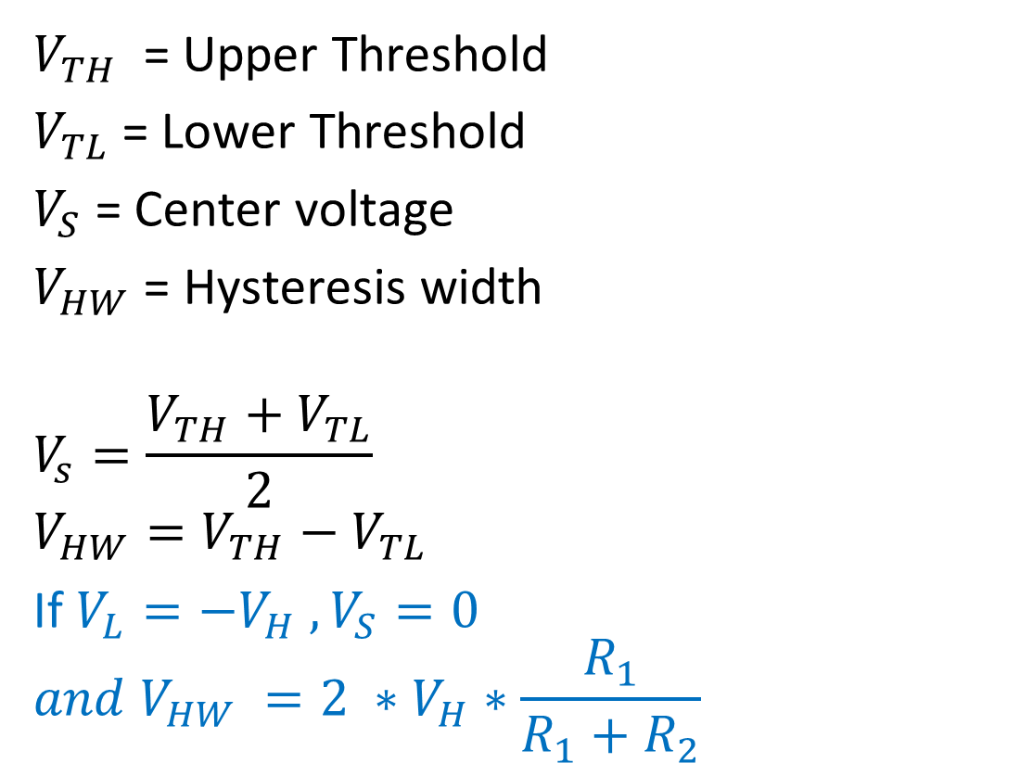
Inverting ST
$V_{TH}$ = Upper Threshold
$V_{TL}$= Lower Threshold
$V_{S}$= Center voltage
$V_{HW}$ = Hysteresis width
$$V_{s}=\frac{V_{TH}+V_{TL}}{2}$$
$$V_{HW}=V_{TH}−V_{TL}$$
If $V_{L}=−V_{H} , V_{S}=0$
$$and V_{HW} =2 ∗V_{H}∗\frac{R_{1}}{R_{1}+R_{2}}$$

Slide 16
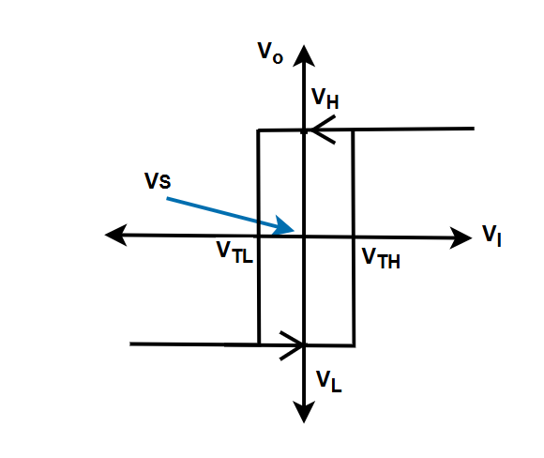
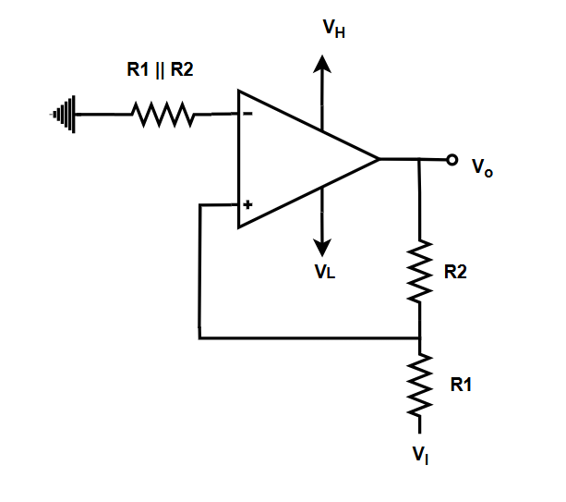
Non-inverting ST
Type here

Slide 17

Non-inverting ST
Formula,
$$V_{TH}=−\frac{R_{1}}{R_{2}} V_{L}$$
$$V_{TL} =−\frac{R_{1}}{R_{2}}V_{H}$$
$$V_{s}=\frac{V_{TH}+V_{TL}}{2}$$
$$V_{HW}=V_{TH}−V_{TL}$$
IF $V_{L}=−V_{H}$
$$V_{S}=0, V_{HW}=2V_{H}\frac{R_{1}}{R_{2}}$$

Slide 18
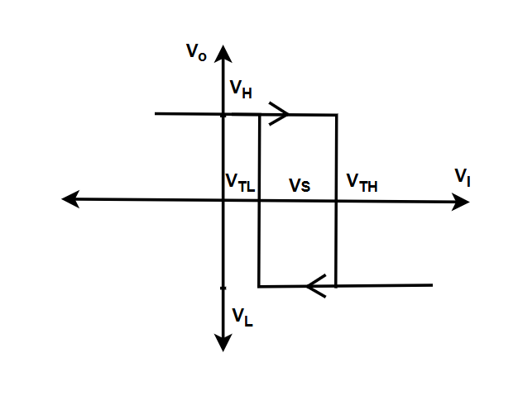
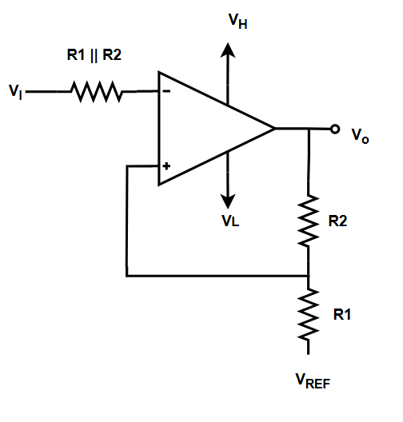
Inverting ST with Ref
Type here

Slide 19
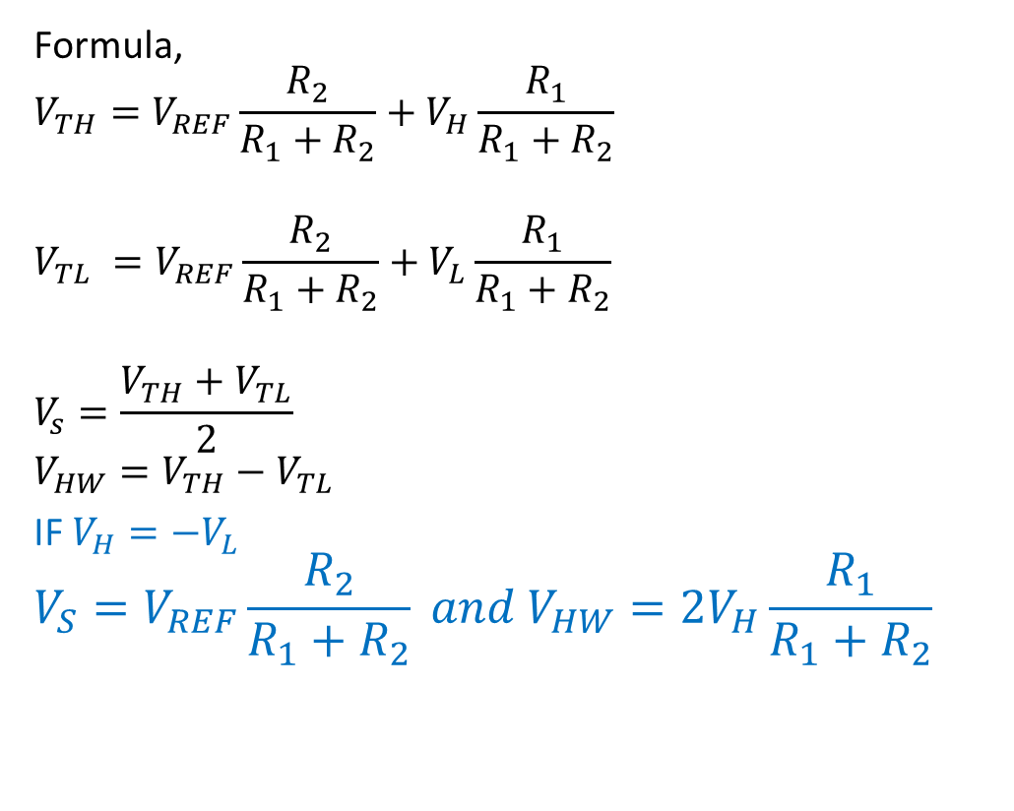
Inverting ST with Ref
Formula,
$$V_{TH}=V_{REF}\frac{R_{2}}{R_{1}+R_{2}}+V_{H}\frac{R_{1}}{R_{1}+R_{2}}$$
$$V_{TL} =V_{REF}\frac{R_{2}}{R_{1}+R_{2}}+V_{L}\frac{R_{1}}{R_{1}+R_{2}}$$
$$V_{s}=\frac{V_{TH}+V_{TL}}{2}$$
$$V_{HW}=V_{TH}−V_{TL}$$
IF $V_{H}=−V_{L}$
$$V_{S}=V_{REF}\frac{R_{2}}{R_{1}+R_{2}} and V_{HW}=2V_{H}\frac{R_{1}}{R_{1}+R_{2}}$$

Slide 20
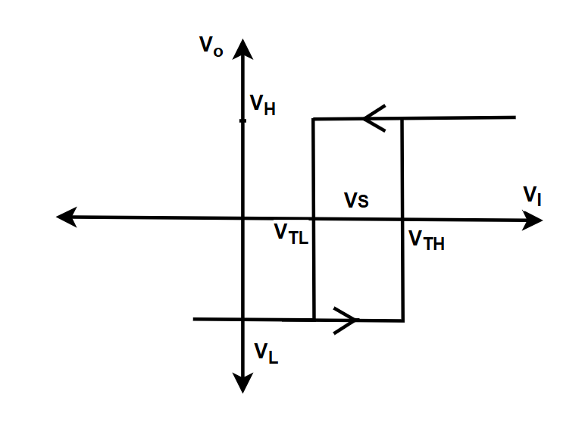
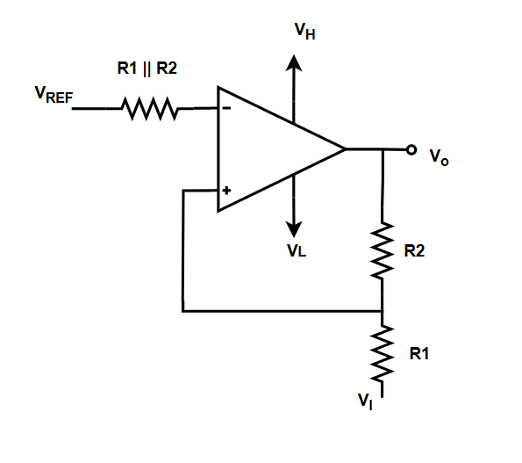
Non-inverting ST with Ref
Type here

Slide 21
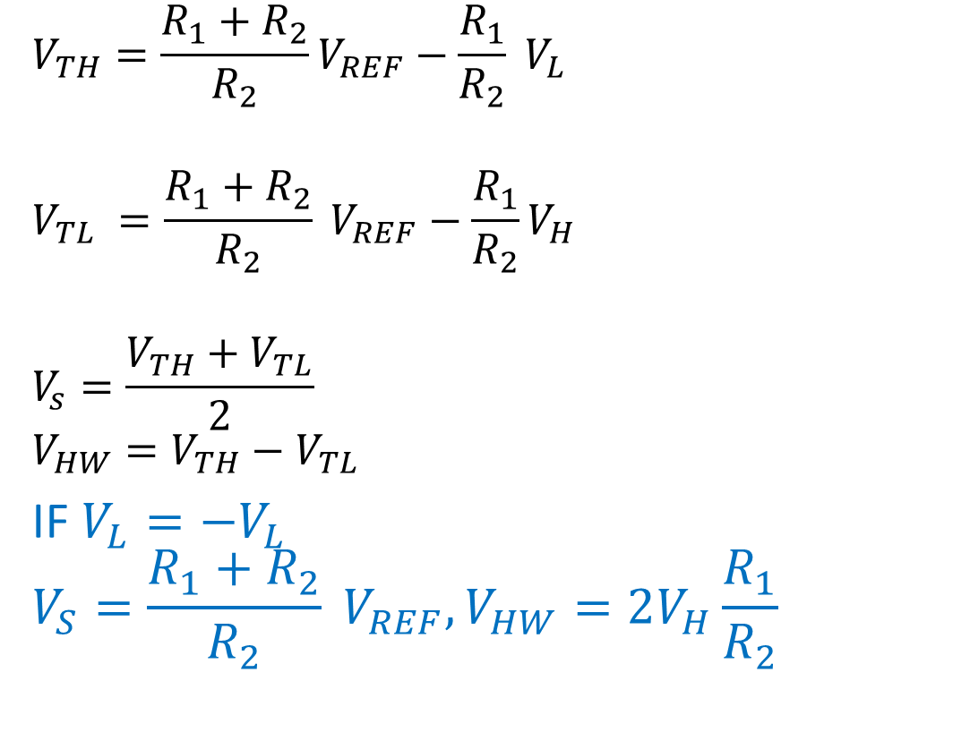
Non-inverting ST with ref
$$V_{TH}=\frac{R_{1}+R_{2}}{R_{2}}V_{REF}−\frac{R_{1}}{R_{2}} V_{L}$$
$$V_{TL} =\frac{R_{1}+R_{2}}{R_{2}} V_{REF}−\frac{R_{1}}{R_{2}}V_{H}$$
$$V_{s}=\frac{V_{TH}+V_{TL}}{2}$$
$$V_{HW}=V_{TH}−V_{TL}$$
IF $V_{L}=−V_{L}$
$$V_{S}=\frac{R_{1}+R_{2}}{R_{2}} V_{REF}, V_{HW}=2V_{H}\frac{R_{1}}{R_{2}}$$

Slide 22
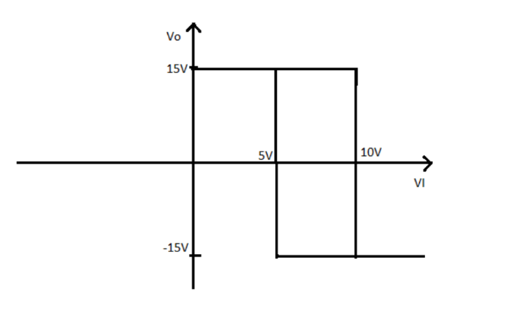
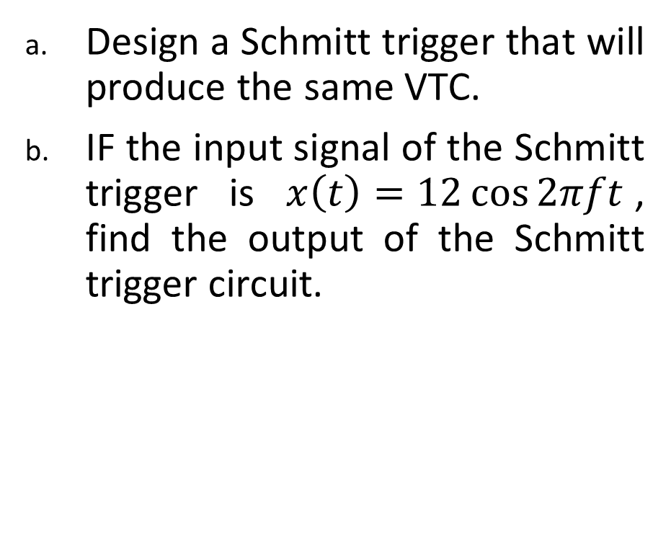
Exercise:
Design a Schmitt trigger that will produce the same VTC.
IF the input signal of the Schmitt trigger is $x\left(t\right)=12\cos{2πft}$, find the output of the Schmitt trigger circuit.

Slide 23
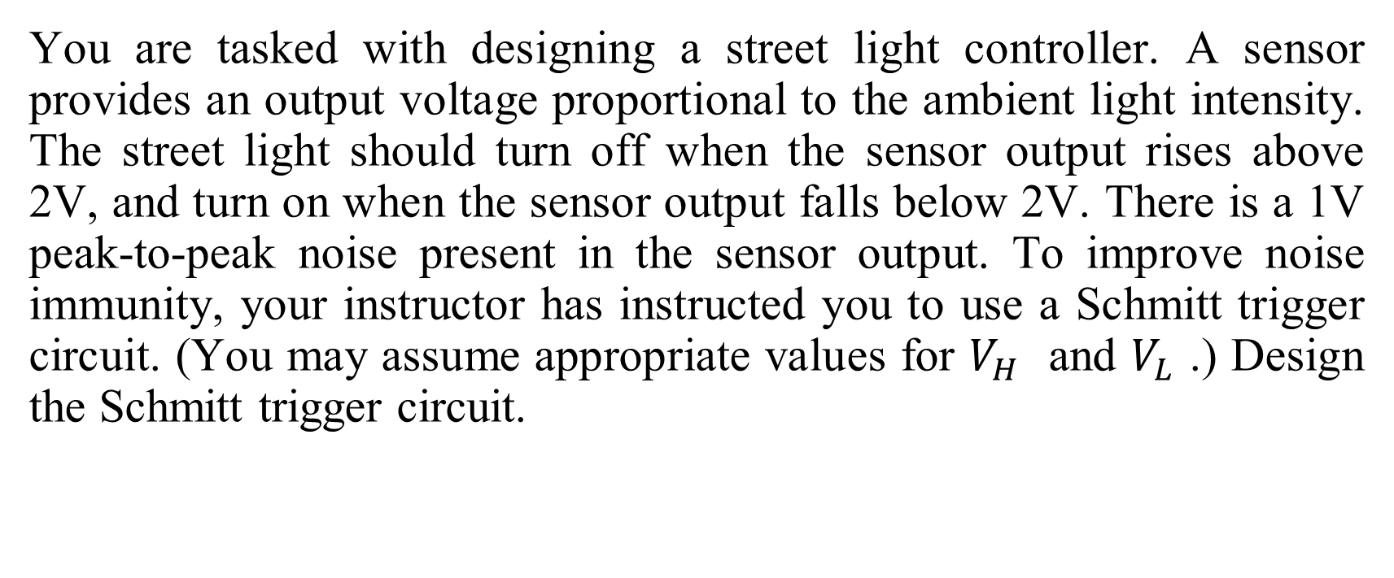
Exercise:
You are tasked with designing a street light controller. A sensor provides an output voltage proportional to the ambient light intensity. The street light should turn off when the sensor output rises above 2V, and turn on when the sensor output falls below 2V. There is a 1V peak-to-peak noise present in the sensor output. To improve noise immunity, your instructor has instructed you to use a Schmitt trigger circuit. (You may assume appropriate values for $V_{H}$​ and $V_{L}$​ .) Design the Schmitt trigger circuit.

